Slide 1


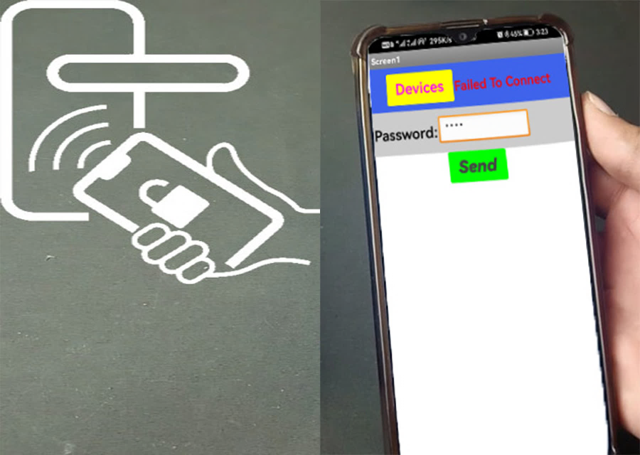
Bluetooth Door Lock
Using Solenoid

Slide 2
Under Supervision
Bluetooth Door Lock
Using Solenoid
Dr. Mustafa El-Tokhy
Eng/ Enas Mustafa

Slide 3
Under Supervision
Dr. Mustafa El-Tokhy
Eng/ Enas Mustafa

Slide 4
Participants
Under Supervision
Dr. Mustafa El-Tokhy
Eng/ Enas Mustafa
أحمد زكريا عبد العال | يحيي محمد محي
إسلام محمود توفيق | أحمد محمد محمود
بهاء أحمد عزب | إسلام أسامة فاروق
ممدوح السيد أحمد | رمزي أحمد رمزي
اشرف محمد إبراهيم | احمد فتحي عواد

Slide 5
Participants
أحمد زكريا عبد العال | يحيي محمد محي
إسلام محمود توفيق | أحمد محمد محمود
بهاء أحمد عزب | إسلام أسامة فاروق
ممدوح السيد أحمد | رمزي أحمد رمزي
اشرف محمد إبراهيم | احمد فتحي عواد

Slide 6

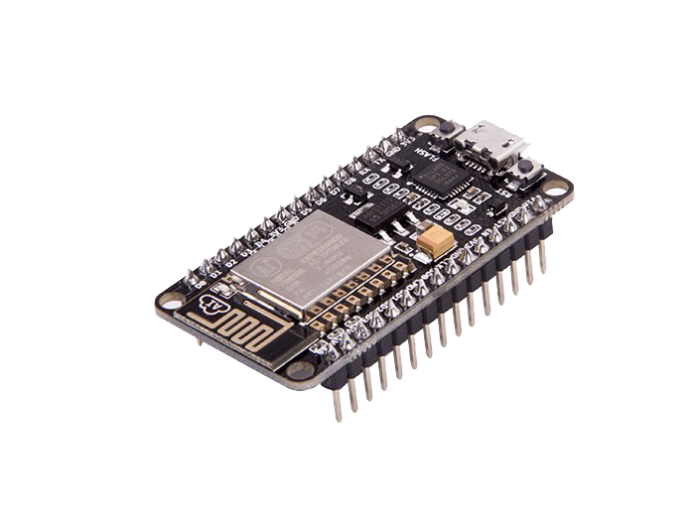
ABCDEFGHIJKLMNOPQRSTUVWXYZ0123456789
ABCDEFGHIJKLMNOPQRSTUVWXYZ0123456789
ABCDEFGHIJKLMNOPQRSTUVWXYZ0123456789
ABCDEFGHIJKLMNOPQRSTUVWXYZ0123456789
ABCDEFGHIJKLMNOPQRSTUVWXYZ0123456789
ABCDEFGHIJKLMNOPQRSTUVWXYZ0123456789
ABCDEFGHIJKLMNOPQRSTUVWXYZ0123456789
Component

Slide 7
ABCDEFGHIJKLMNOPQRSTUVWXYZ0123456789
ABCDEFGHIJKLMNOPQRSTUVWXYZ0123456789
ABCDEFGHIJKLMNOPQRSTUVWXYZ0123456789
ABCDEFGHIJKLMNOPQRSTUVWXYZ0123456789
Component
ABCDEFGHIJKLMNOPQRSTUVWXYZ0123456789
ABCDEFGHIJKLMNOPQRSTUVWXYZ0123456789
ABCDEFGHIJKLMNOPQRSTUVWXYZ0123456789
Micro Controller

Slide 8
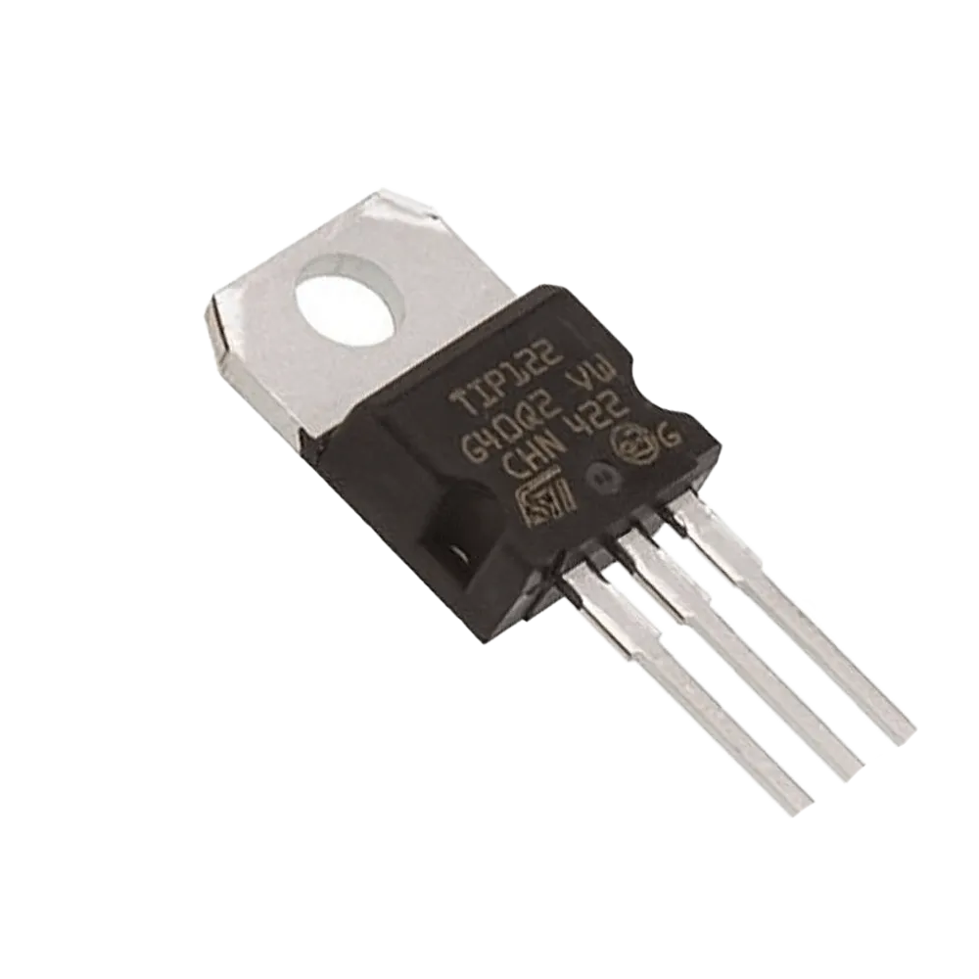
ABCDEFGHIJKLMNOPQRSTUVWXYZ0123456789
ABCDEFGHIJKLMNOPQRSTUVWXYZ0123456789
ABCDEFGHIJKLMNOPQRSTUVWXYZ0123456789
ABCDEFGHIJKLMNOPQRSTUVWXYZ0123456789
ABCDEFGHIJKLMNOPQRSTUVWXYZ0123456789
ABCDEFGHIJKLMNOPQRSTUVWXYZ0123456789
ABCDEFGHIJKLMNOPQRSTUVWXYZ0123456789
Component

Slide 9
ABCDEFGHIJKLMNOPQRSTUVWXYZ0123456789
ABCDEFGHIJKLMNOPQRSTUVWXYZ0123456789
ABCDEFGHIJKLMNOPQRSTUVWXYZ0123456789
ABCDEFGHIJKLMNOPQRSTUVWXYZ0123456789
ABCDEFGHIJKLMNOPQRSTUVWXYZ0123456789
ABCDEFGHIJKLMNOPQRSTUVWXYZ0123456789
Component
ABCDEFGHIJKLMNOPQRSTUVWXYZ0123456789
Darlington Transistor

Slide 10
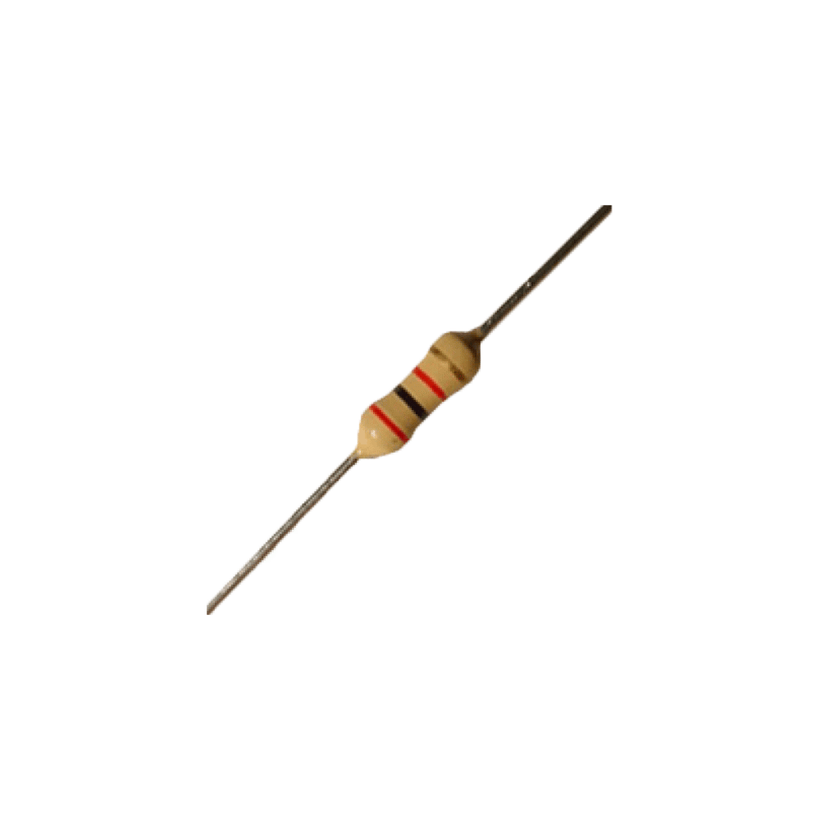
ABCDEFGHIJKLMNOPQRSTUVWXYZ0123456789
ABCDEFGHIJKLMNOPQRSTUVWXYZ0123456789
ABCDEFGHIJKLMNOPQRSTUVWXYZ0123456789
ABCDEFGHIJKLMNOPQRSTUVWXYZ0123456789
ABCDEFGHIJKLMNOPQRSTUVWXYZ0123456789
ABCDEFGHIJKLMNOPQRSTUVWXYZ0123456789
ABCDEFGHIJKLMNOPQRSTUVWXYZ0123456789
Component

Slide 11
ABCDEFGHIJKLMNOPQRSTUVWXYZ0123456789
ABCDEFGHIJKLMNOPQRSTUVWXYZ0123456789
ABCDEFGHIJKLMNOPQRSTUVWXYZ0123456789
ABCDEFGHIJKLMNOPQRSTUVWXYZ0123456789
ABCDEFGHIJKLMNOPQRSTUVWXYZ0123456789
ABCDEFGHIJKLMNOPQRSTUVWXYZ0123456789
Component
ABCDEFGHIJKLMNOPQRSTUVWXYZ0123456789
Resistors

Slide 12
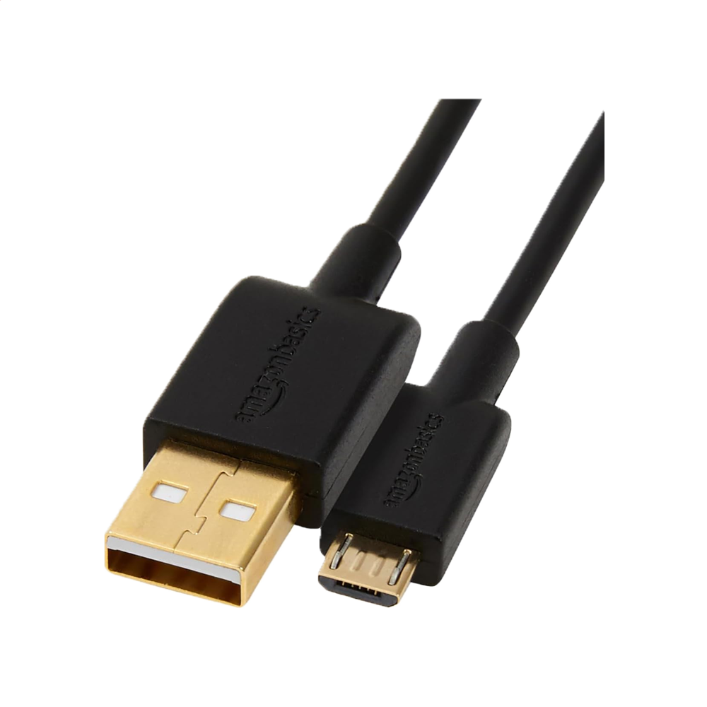
ABCDEFGHIJKLMNOPQRSTUVWXYZ0123456789
ABCDEFGHIJKLMNOPQRSTUVWXYZ0123456789
ABCDEFGHIJKLMNOPQRSTUVWXYZ0123456789
ABCDEFGHIJKLMNOPQRSTUVWXYZ0123456789
ABCDEFGHIJKLMNOPQRSTUVWXYZ0123456789
ABCDEFGHIJKLMNOPQRSTUVWXYZ0123456789
ABCDEFGHIJKLMNOPQRSTUVWXYZ0123456789
Component

Slide 13
ABCDEFGHIJKLMNOPQRSTUVWXYZ0123456789
ABCDEFGHIJKLMNOPQRSTUVWXYZ0123456789
ABCDEFGHIJKLMNOPQRSTUVWXYZ0123456789
Component
ABCDEFGHIJKLMNOPQRSTUVWXYZ0123456789
ABCDEFGHIJKLMNOPQRSTUVWXYZ0123456789
ABCDEFGHIJKLMNOPQRSTUVWXYZ0123456789
ABCDEFGHIJKLMNOPQRSTUVWXYZ0123456789
Micro USB Cable

Slide 14
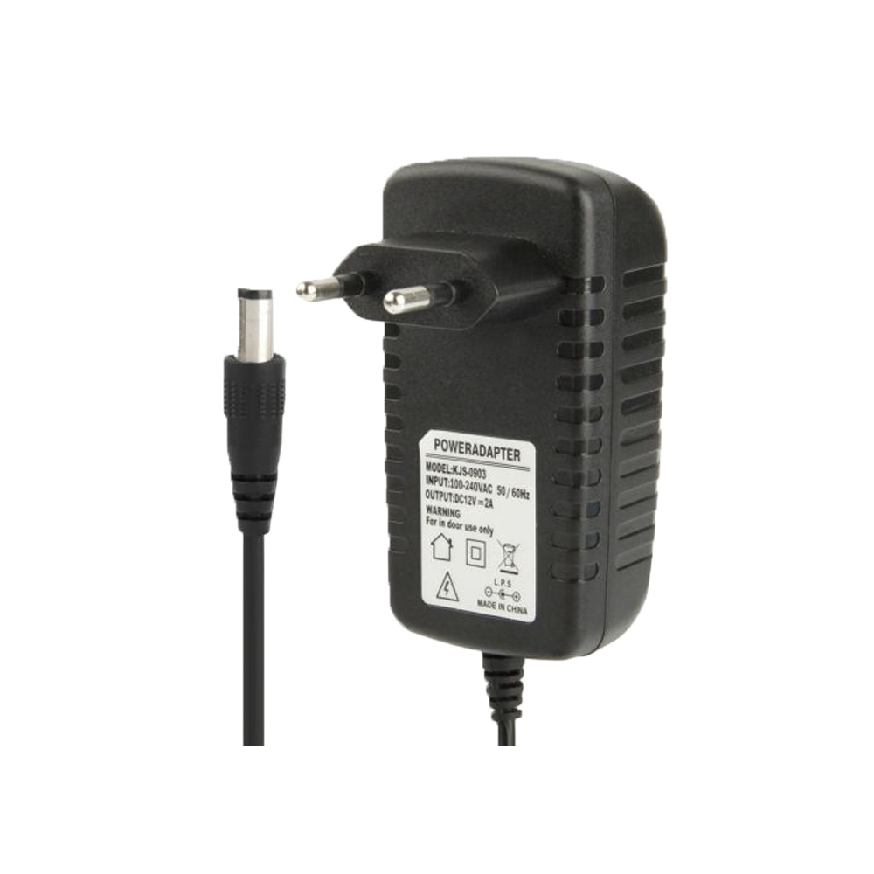
ABCDEFGHIJKLMNOPQRSTUVWXYZ0123456789
ABCDEFGHIJKLMNOPQRSTUVWXYZ0123456789
ABCDEFGHIJKLMNOPQRSTUVWXYZ0123456789
ABCDEFGHIJKLMNOPQRSTUVWXYZ0123456789
ABCDEFGHIJKLMNOPQRSTUVWXYZ0123456789
ABCDEFGHIJKLMNOPQRSTUVWXYZ0123456789
ABCDEFGHIJKLMNOPQRSTUVWXYZ0123456789
Component

Slide 15
ABCDEFGHIJKLMNOPQRSTUVWXYZ0123456789
ABCDEFGHIJKLMNOPQRSTUVWXYZ0123456789
ABCDEFGHIJKLMNOPQRSTUVWXYZ0123456789
ABCDEFGHIJKLMNOPQRSTUVWXYZ0123456789
ABCDEFGHIJKLMNOPQRSTUVWXYZ0123456789
ABCDEFGHIJKLMNOPQRSTUVWXYZ0123456789
ABCDEFGHIJKLMNOPQRSTUVWXYZ0123456789
Component
DC Source

Slide 16
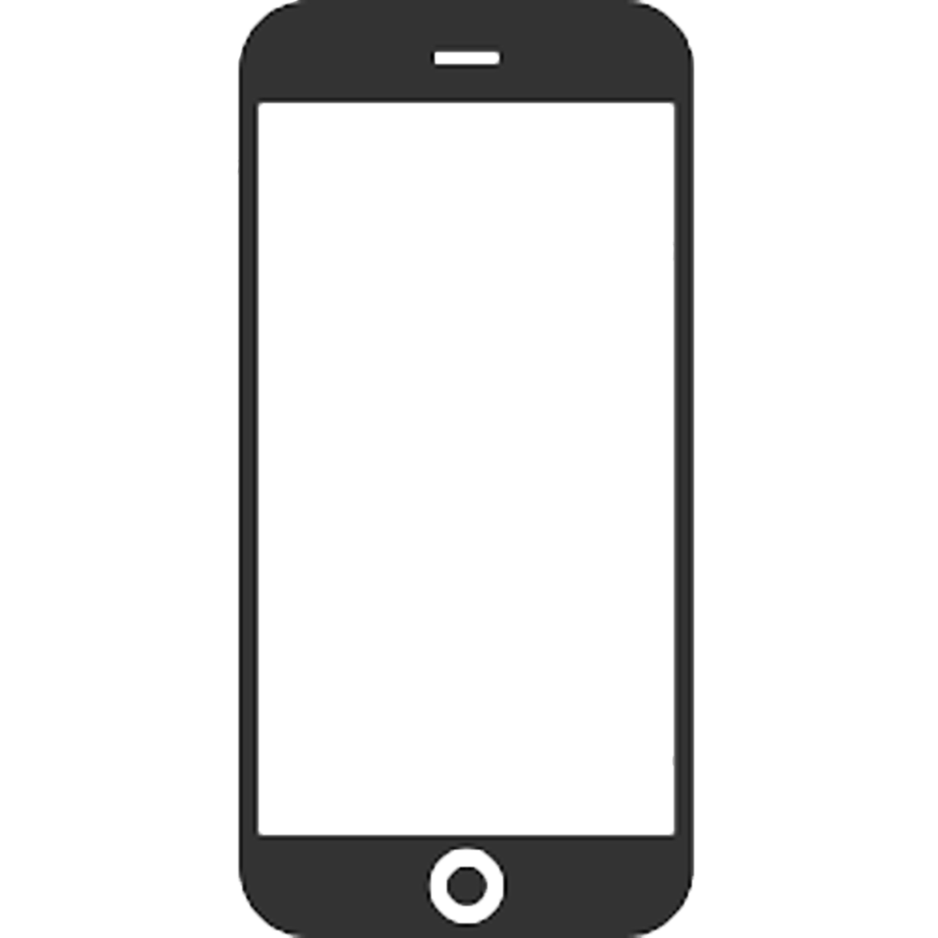
ABCDEFGHIJKLMNOPQRSTUVWXYZ0123456789
ABCDEFGHIJKLMNOPQRSTUVWXYZ0123456789
ABCDEFGHIJKLMNOPQRSTUVWXYZ0123456789
ABCDEFGHIJKLMNOPQRSTUVWXYZ0123456789
ABCDEFGHIJKLMNOPQRSTUVWXYZ0123456789
ABCDEFGHIJKLMNOPQRSTUVWXYZ0123456789
ABCDEFGHIJKLMNOPQRSTUVWXYZ0123456789
Component

Slide 17
ABCDEFGHIJKLMNOPQRSTUVWXYZ0123456789
ABCDEFGHIJKLMNOPQRSTUVWXYZ0123456789
ABCDEFGHIJKLMNOPQRSTUVWXYZ0123456789
ABCDEFGHIJKLMNOPQRSTUVWXYZ0123456789
ABCDEFGHIJKLMNOPQRSTUVWXYZ0123456789
Component
ABCDEFGHIJKLMNOPQRSTUVWXYZ0123456789
ABCDEFGHIJKLMNOPQRSTUVWXYZ0123456789
Mobile Phone & Application

Slide 18
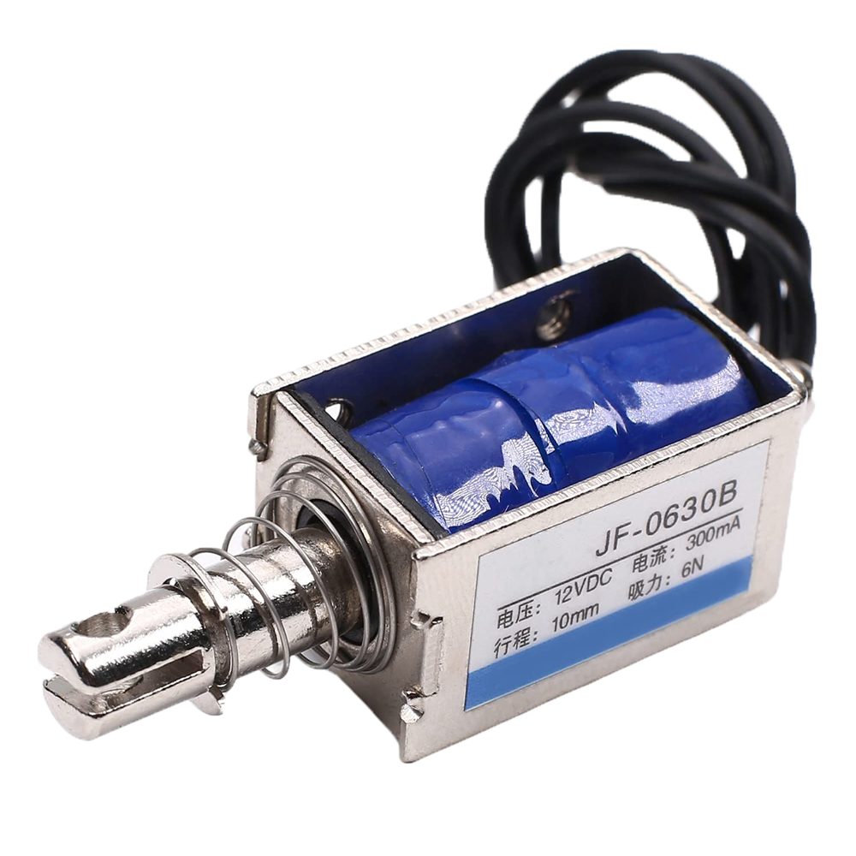
ABCDEFGHIJKLMNOPQRSTUVWXYZ0123456789
ABCDEFGHIJKLMNOPQRSTUVWXYZ0123456789
ABCDEFGHIJKLMNOPQRSTUVWXYZ0123456789
ABCDEFGHIJKLMNOPQRSTUVWXYZ0123456789
ABCDEFGHIJKLMNOPQRSTUVWXYZ0123456789
ABCDEFGHIJKLMNOPQRSTUVWXYZ0123456789
ABCDEFGHIJKLMNOPQRSTUVWXYZ0123456789
Component

Slide 19
ABCDEFGHIJKLMNOPQRSTUVWXYZ0123456789
ABCDEFGHIJKLMNOPQRSTUVWXYZ0123456789
ABCDEFGHIJKLMNOPQRSTUVWXYZ0123456789
ABCDEFGHIJKLMNOPQRSTUVWXYZ0123456789
ABCDEFGHIJKLMNOPQRSTUVWXYZ0123456789
ABCDEFGHIJKLMNOPQRSTUVWXYZ0123456789
Component
ABCDEFGHIJKLMNOPQRSTUVWXYZ0123456789
Solenoid

Slide 20
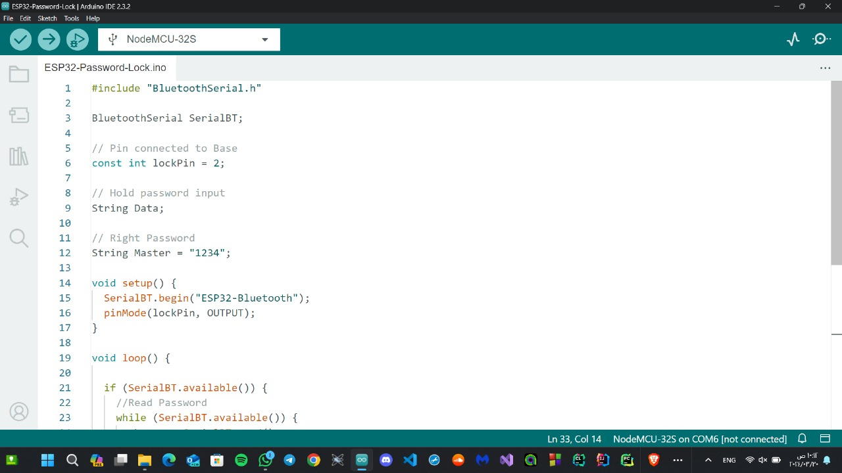
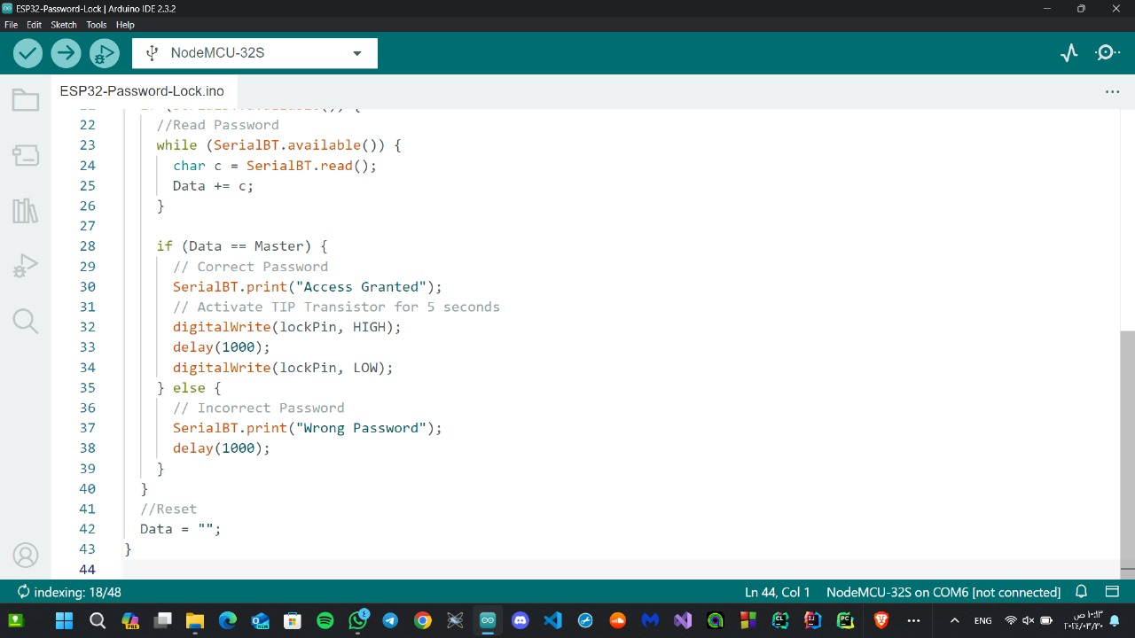

Slide 23
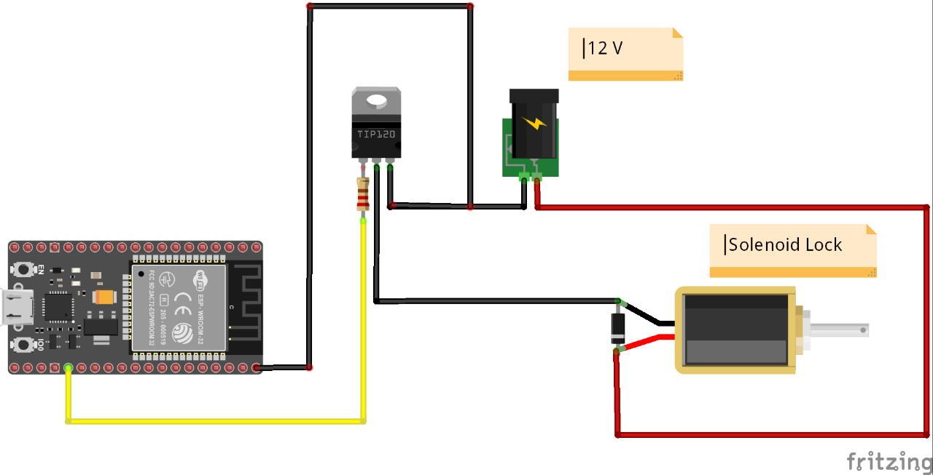
Circuit Diagram

Slide 24

Circuit Diagram
The idea of the project is a wireless connection via Bluetooth to the microcontroller, which sends an electrical signal to the transistor so that the Solenoid is activated and the door lock is opened.

Slide 25
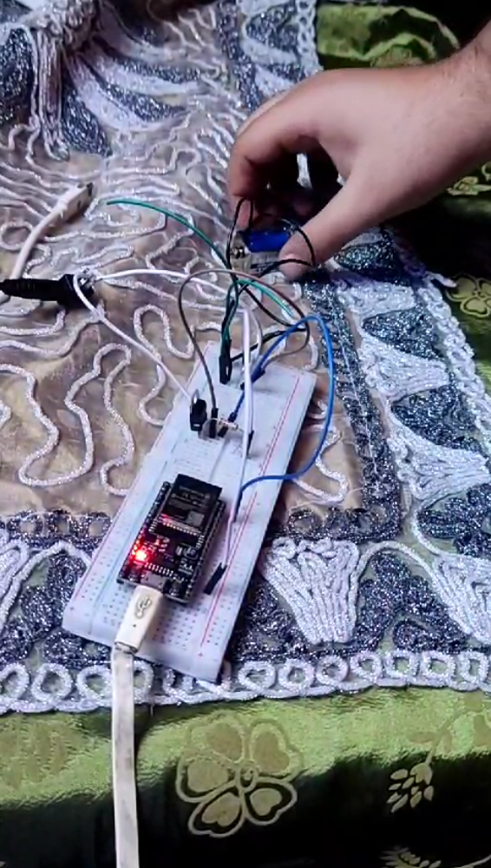
The Project Description
The idea of the project is a wireless connection via Bluetooth to the microcontroller, which sends an electrical signal to the transistor so that the Solenoid is activated and the door lock is opened.

Slide 26
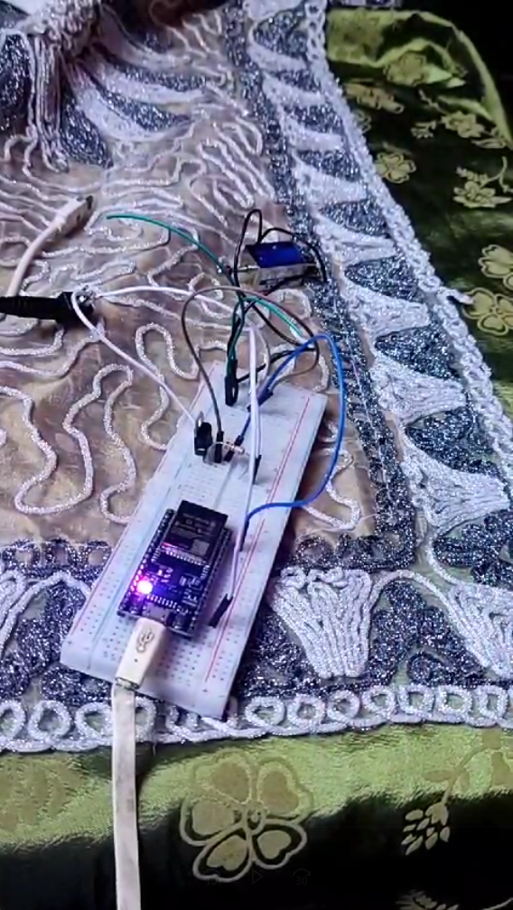
Practical Image of the Project

Slide 27
Practical Image of the Project

